Slide 1
Community Climate Action Fund

Slide 2
Community Climate Action Programme
The Community Climate Action Programme (CCAP) is a new programme to support small and large, rural and urban communities to take climate action at a local level in the Republic of Ireland.
Strand 1A of the fund focuses on cross-border projects in partnership with communities and organisations in NI.
Organisations in the district could partner with an organisation in ROI to be a joint beneficiary of the fund.

Slide 3
Strand 1A Overview
€3 Million for Island of Ireland
100% project funding
Climate action for cross-border climate action partnerships and interventions
Project must be completed in 18 months from letter of offer

Slide 4
Funding Available
The CCAP can fund 100% of all eligible costs for the project and there are three project sizes eligible:
Small scale projects < €20,000
Medium scale projects €20,000 to €50,000
Large scale projects €51,000 to €100,000
However as these projects must be delivered in partnership with organisations in ROI, groups in NI are only able to get 50% of this.

Slide 5
Who can apply?
Not-for-profit organisation
Community or environmental organisations
Local Authorities in NI
NOT Eligible to Apply:
Private individuals
Commercial undertakings (including sole traders)
Schools or 3rd Level

Slide 6
Eligible Projects
Reduce, or support the reduction of, greenhouse gas emissions
Increase the production, or use, of renewable energy
Improve energy efficiency
Increase climate resilience
Nature based projects that enhance biodiversity and seek to reduce, or increase the removal of, greenhouse gas emissions or support climate resilience.
Innovative solutions to reduce greenhouse gas emissions

Slide 7
Project themes
Community/energy: aim to reduce the climate impact of buildings in communities by using less energy, utilising renewable energy and avoiding heat loss.
Could include: LED community lighting, small renewable energy projects (solar / hydro / wind), rainwater harvesting, retrofitting community buildings (windows & doors, insulation, LED lighting, heat pumps).
Travel: contribute to emissions reductions related to travel
Could include: Cycle parking / racks, improving cycle way access, safe and active routes to schools, eCargo bikes, bike repair hubs, bike libraries
Food/waste: reduce food waste
Could include: Community composting facilities, community gardens / allotments, community fridges, Food pledges from local businesses, Food markets
Shopping and Recycling: Increase the variety and number of recycling facilities in the local community and initiatives aimed at reducing, reusing and recycling.
Could include: Swap shops, water filling stations, single use plastics elimination, musical instrument reuse, paint recycling, toy library, Initiatives aimed at reducing waste-reusable coffee cups, Community repair hubs, a library of things
Local Climate and environmental action: take a holistic approach to managing the local environment, including in relation to climate action
Could include: measures to reduce harmful effects of extreme climate events such as planted mounds to slow flood water, constructed storm water wetlands. Mini forests, dispersed orchards (fruit trees), community gardens, roof gardens, pollinator projects, Ponds, Rain Gardens/SUDS, Climate resilience projects
Projects may comprise several of the suggested project types and we would encourage innovation in project ideas

Slide 9
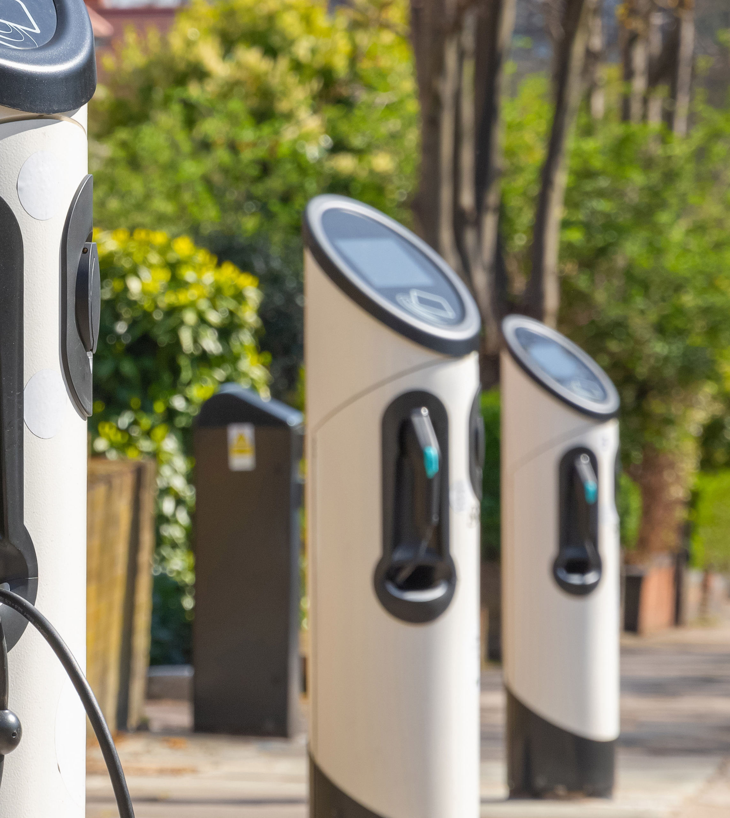
Eligible Costs
Predominantly capital
For the sole purpose of implementing the project and necessary for delivery
Verifiable and reasonable
No duplicate public funding but can have match funding as long as the CCAP funding component can stand on its own merits and be independent of the other funding.
Must comply with State Aid requirements

Slide 10
Ineligible Costs
Projects that solely benefit an individual
•Teaching/staffing
•Travel and transport costs except in exceptional circumstances
•Equipment, unless directly associated with the project
•Income generating projects
•Overheads, ongoing running costs
•Insurance
•Accommodation and subsistence
•Redundancy costs
•Penalties/Interest/Bank Interest/Charges
•Loan repayments
•Retrospective costs i.e. expenditure which has taken place prior to approval
date of the project
Costs for which more appropriate funding opportunities already exist are ineligible, where it is clear that Community Climate Action Programme funding is a substitute for other public funding which is currently available
Notional costs e.g. the room hire within the applicant’s own premises
Legal Fees
This list is not exhaustive.

Slide 11
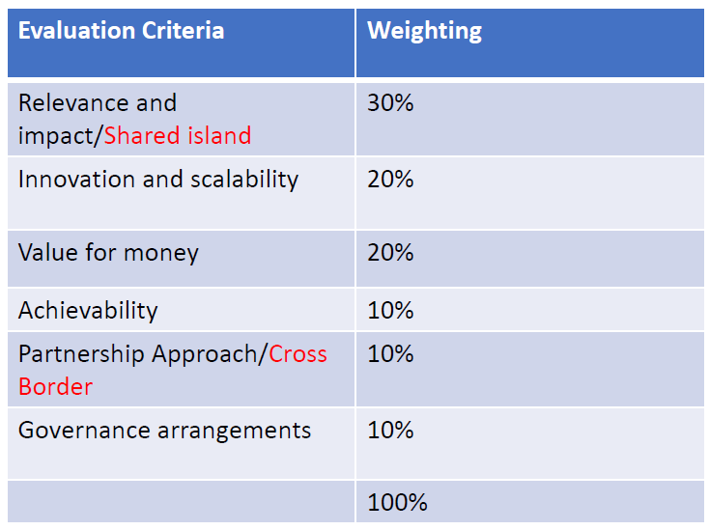
How will projects be evaluated, selected and approved?
1. Evaluation by Local Authority in ROI:
Need to achieve at least 50% and the minimum requirements against the evaluation criteria
2. Selection by Local Authority in ROI:
Final selection of projects taking account of:
the geographical distribution of projects
the desirability to fund a variety of different projects and across multiple themes
the contribution of the projects to the climate action objectives of local authority in ROI
3. Approval by DECC:
Decision made by Minister of the Environment, Climate and Communications (8-12 weeks)

Slide 12
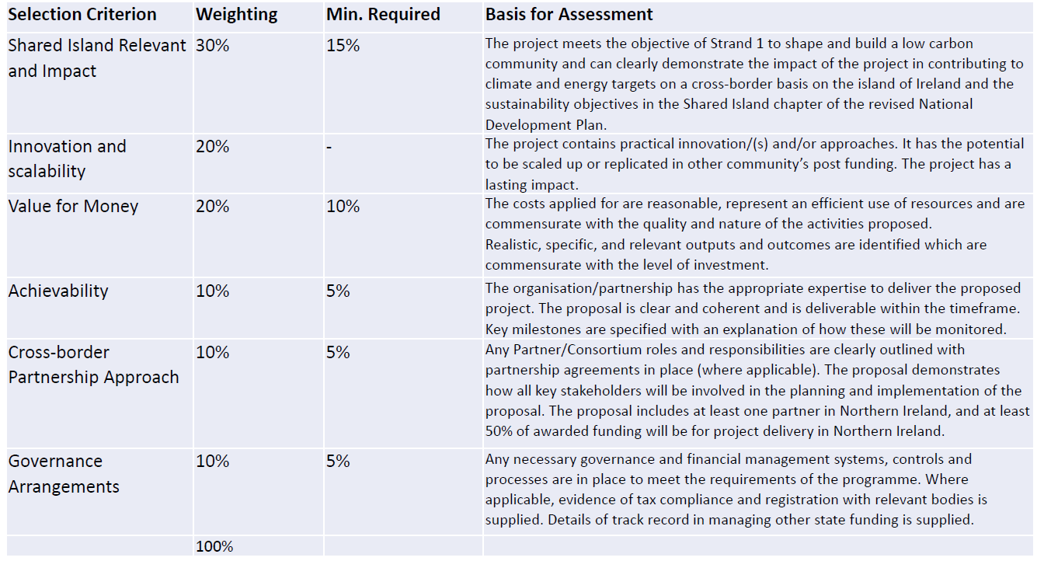
How will projects be evaluated, selected and approved?

Slide 13
Frequently Asked Questions
Pre-funding is available- 25% but the next tranche of 25% is available after initial 25% is paid and so on up to 100% of funding.
Groups Need contingency funding in place (10/20%)
You need to have evidence of 3 quotes
Solar Panels- Roofs need to be structurally strong enough to support panels
Planning permission needs to be in place + all permissions
Applications have already opened and deadlines vary depending on the local authority in ROI to which you are applying but vary from early to late March 2024.
Projects are like to start Q4 2024.
For more information please contact climate@fermanaghomagh

